Slide 1
Beta Neutral Portfolio Optimization
Name: Mary Nyone, Raj Ramchandani, Zeal Shah
Professor: Dan Wang, Zhiyuan Yao
Course: Introduction to Python For Financial Applications

Slide 2
Objective
Working as an adviser- Produce an optimal investment strategy to minimize market exposure in his/her portfolio (beta neutral portfolio)
Investor has a low risk tolerance and primarily concerned with capital preservation and a certain level of return. Investor’s initial investment is $1 million dollars
We create a beta-neutral portfolio comprising long-short positions in blue chip stocks selected based on certain factors e.g value, momentum, opinion etc.

Slide 3
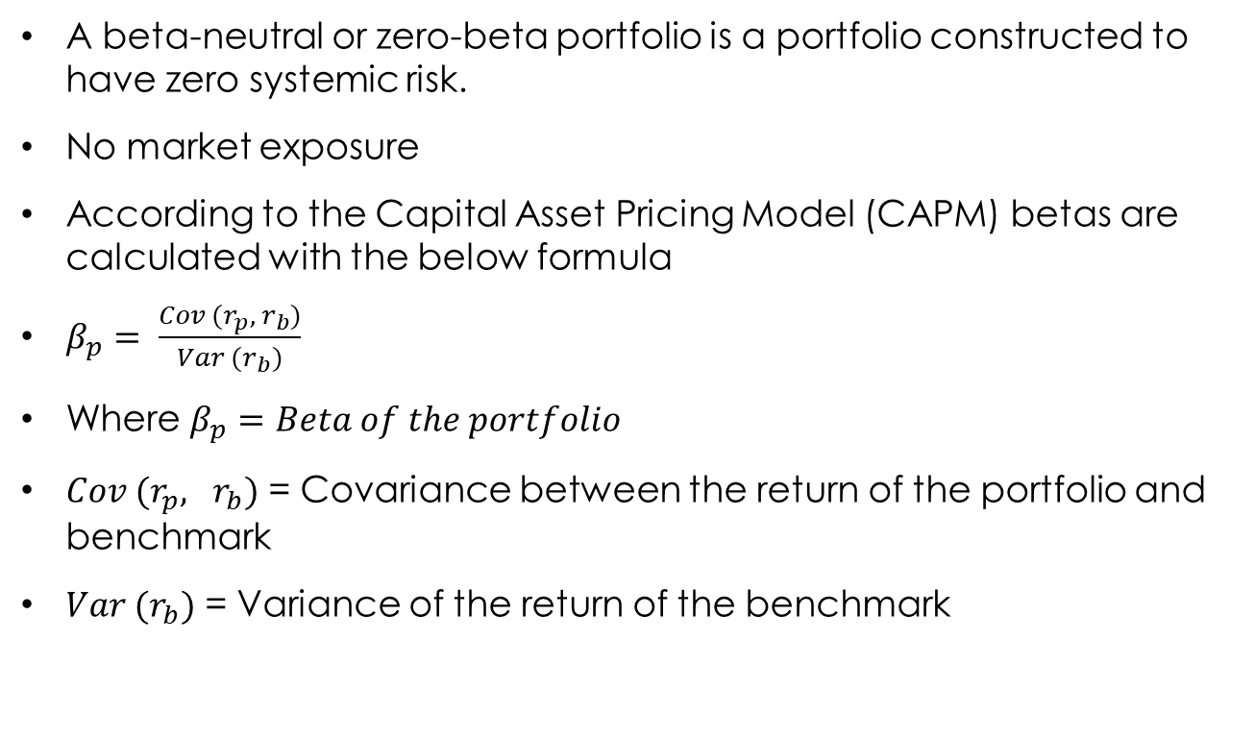
What is Beta Neutral Portfolio
A beta-neutral or zero-beta portfolio is a portfolio constructed to have zero systemic risk.
No market exposure
According to the Capital Asset Pricing Model (CAPM) betas are calculated with the below formula
$β_{p}= \frac{Cov (r_{p}, r_{b})}{Var (r_{b})}$
Where $β_{p}=Beta of the portfolio$
$Cov (r_{p}, r_{b})$ = Covariance between the return of the portfolio and benchmark
$Var (r_{b})$ = Variance of the return of the benchmark

Slide 4
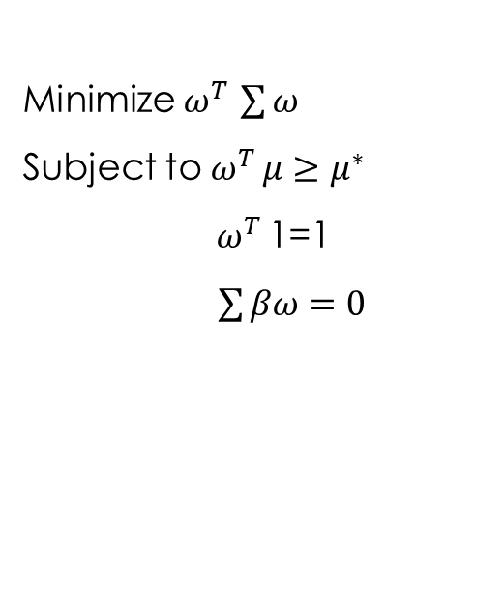
Optimization Problem: Finding Optimal Weights
Minimize $ω^{T }\sum{ω}$
Subject to $ω^{T }μ≥μ^{∗}$
$ω^{T }$1=1
$\sum{βω}=0$
Minimize the portfolio variance ̴ minimum volatility (risk)
The expected mean return is at least some target return
Weight sum up to 100%
Beta of portfolio is 0

Slide 5
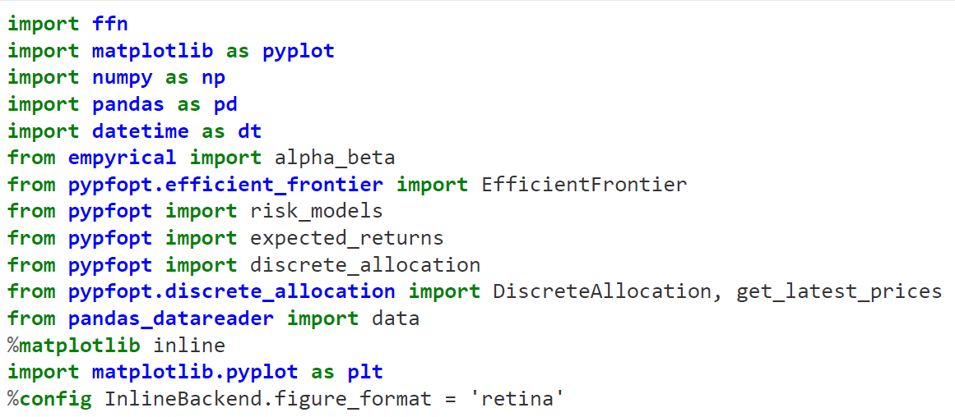
Python : Libraries
ffn: Work with quantitative finance functions
empyrical: Use for common financial matrix
- We used it to Calculate Beta Value
pypfopt: Implements portfolio optimization methods

Slide 6
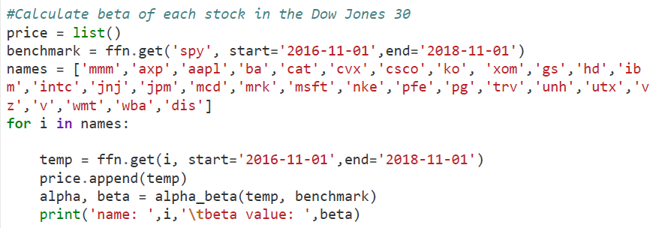
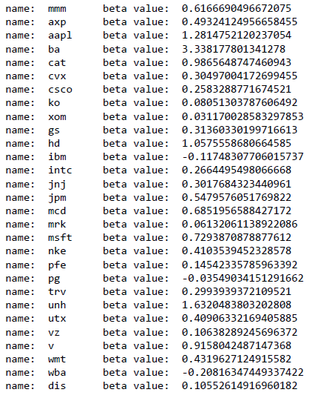
Python Code
First Step:
Dow Jones 30 stocks and calculated the beta of each stocks
We calculated the beta value from November 1st, 2016 to November 1st , 2018.
Result:

Slide 7
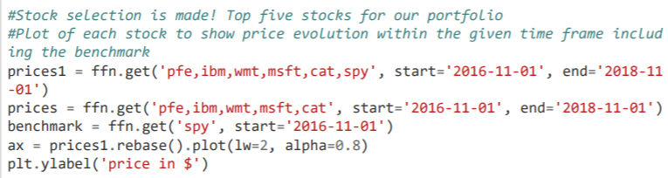
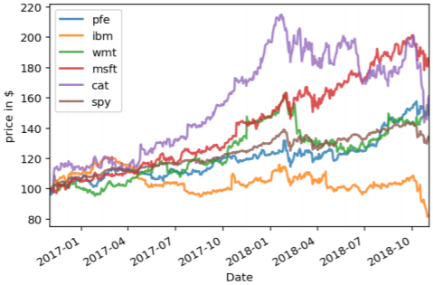
Python Code
Second Step:
Selected the top 5 stocks for our portfolio
We have taken “spy” stock as a benchmark and plot the graph in the time frame.

Slide 8
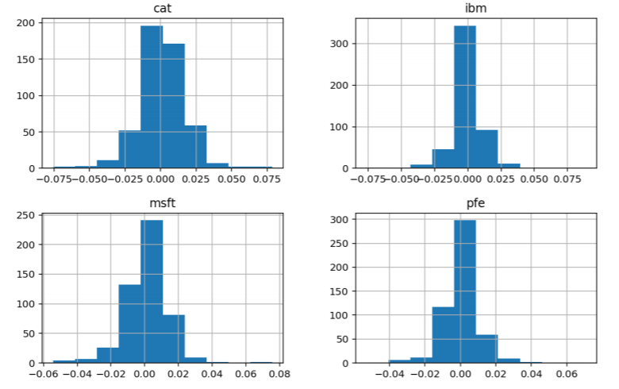
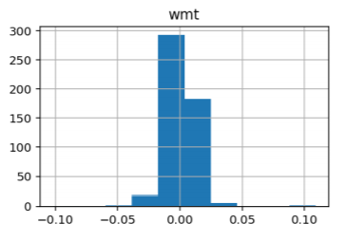
Python Code
Histogram Result of the first five stocks:

Slide 9
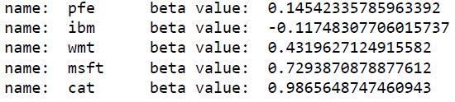
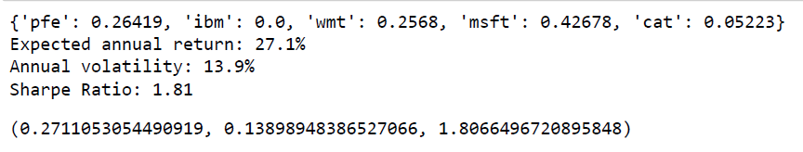
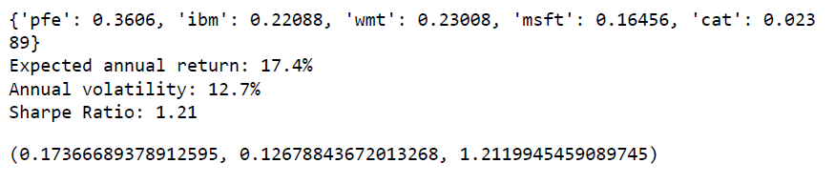
Python Code
Third Step:
Calculated the beta value for each stock from year 2016 to 2018
First, maximize Sharpe ratio utilizes risk to maximize returns
Minimized volatility reduces risk, also the return on investment

Slide 10
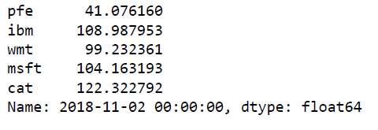
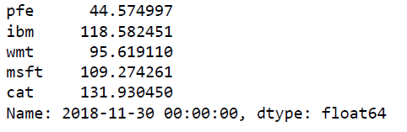
Python Code
Fourth Step:
To achieve beta-neutrality with a given set of target return. Allowing both long and short selling.
Calculating the weights at proper allocation gives number of shares that you purchase for each stock
Calculated price at the beginning and at the end of the month
Funds you should purchase:
Price at the beginning of the month:
Price at the end of the month:

Slide 11
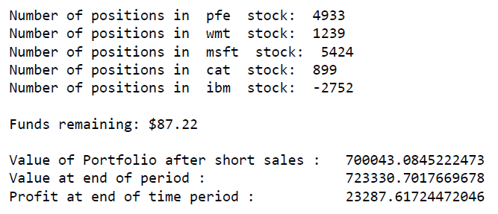
Python Code
Fifth Step:
Result of one month:

Slide 12
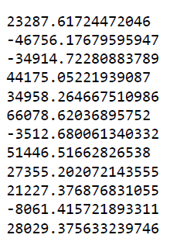
Python Code
Last Step:
Calculated the monthly return for each month for 1 year with the investment of $1 Million Dollars:
Result of each month and total return after 1 year:

Slide 13
Backtesting/Results
Comparing the Performance of our Portfolio to the S&P 500
Date | S&P 500 Returns | Beta-Neutral Portfolio
Dec 31 2018 | -9.18% | 2.32%
Jan 31 2019 | 7.87% | -4.68%
Feb 28 2019 | 2.97% | -3.5%
Mar 31 2019 | 1.79% | 4.4%
Apr 30 2019 | 3.93% | 3.5%
May 31 2019 | -6.58% | 6.6%
Jun 30 2019 | 6.89% | -0.3%
July 31 2019 | 1.31% | 5.14%
Aug 31 2019 | -1.81% | 2.74%
Sept 30 2019 | 1.72% | 2.12%
Oct 31 2019 | 2.04% | -0.8%
Nov 30 2019 | 3.40% | 2.8%

Slide 14
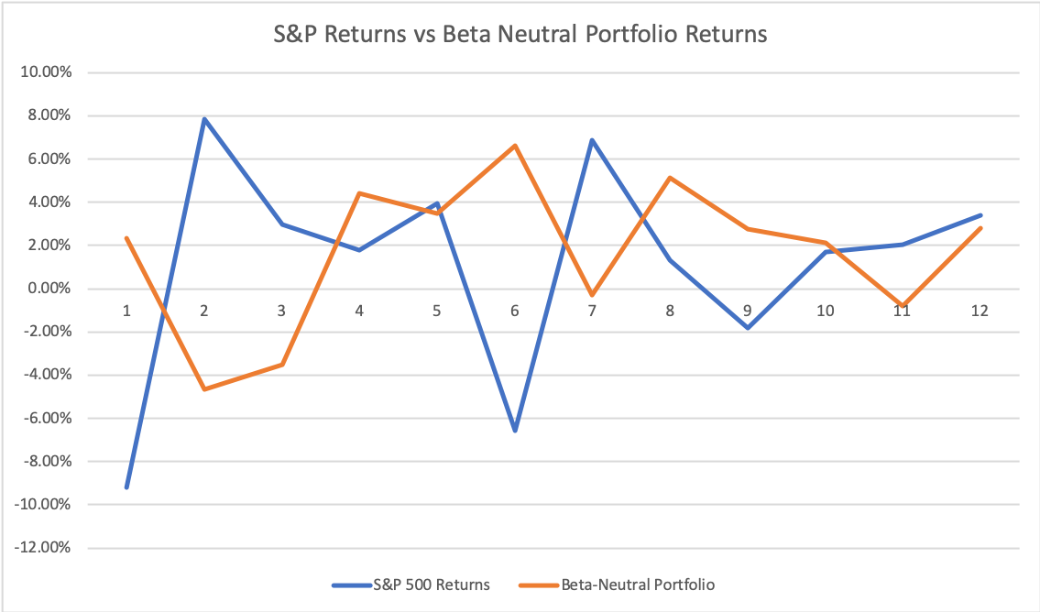
Plot of Returns

Slide 15
Limitations/Challenges
Theory Vs Reality.
Reality is more complicated than theory. Hedge fund managers use other tools e.g verticals and put strategies to hedge trade portfolios
Rebalancing and adjustments are based on assumptions- Practical use and human opinion does matter.
Voiding/deleting any of the stock in not possible in our model, e.g bankruptcy.
Political events and influence of market doesn't effect this model
Beta values changes over time
Transaction cost are assumed to be 0

Slide 16
Future prospects
Adjust our portfolio choices to allow for market factors or trigger events
We can improve on this algorithm and reduce our limitations
We should Start a “Hedge Fund”

Slide 17
References
Markowitz, H. (1952). Portfolio Selection. The Journal of Finance, 7(1), 77 91. https://doi.org/10.1111/j.1540-6261.1952.tb01525.x
William F. Sharpe, 1964. "Capital Asset Prices: A Theory Of Market Equilibrium Under Conditions Of Risk," Journal of Finance, American Finance Association, vol. 19(3), pages 425-442, September.
Charlotte Werger - Modern portfolio theory INTRODUCTION TO PORTFOLIO ANALYSIS IN PYTHON https://s3.amazonaws.com/assets.datacamp.com/production/course_18408/slides/chapter4.pdf
ffn - Financial Functions for Python https://pmorissette.github.io/ffn/
robertmartin8/PyPortfolioOpt github
https://mybinder.org/v2/gh/mmngreco/quantdare_posts/master?filepath=calcular_retornos/agregate_returns.ipynb
Mcgreco. Three approaches to calculate monthly returns...with Pandas! (2018, January 15). Retrieved from https://quantdare.com/calculate-monthly-returns-with-pandas/.

Slide 18
Thank You

